Slide 1

Deep Learning-based Feature Selection for Cancer Genomics
Presented By-
Aditya Jain (CSE, 1903102)
Satvik Bhatnagar (MnC, 1903215)
Supervisor-
Dr. Clint Pazhayidam George
Ms. Akanksha Mishra
School of Mathematics and Computer Sciences (SMCS)
Indian Institute of Technology, Goa
2nd March 2023

Slide 2
Table of Contents
Introduction
Results and Discussion:
Derivation
Code Implementation
Future plan for Improvements
References

Slide 3
Introduction
The aim of this project is to implement Deep Learning methods like Sparse BNNs and Variational Inference to select essential genes that contribute to the growth of a particular cancer type using publicly available gene expression data.
In Cancer Genomics, the data typically includes information about the genetic mutations, copy number alterations, gene expression levels, and epigenetic modifications in the cancer cells.
Problems
This data is often high-dimensional and noisy, making it challenging to identify the most relevant features or biomarkers that can predict clinical outcomes.
Moreover, gathering the data for cancer-related research is costly, slow, as well as difficult.
The dataset we use has much more features than the number of samples (also called the p (Predictors) >>n (Samples) case).
This calls for specialized data preparation and modeling algorithms to address them correctly.

Slide 4
Objectives Achieved So Far
Worked towards understanding the regression model in the “Efficient Variational Inference for Sparse Deep Learning” paper.
Gained knowledge on various topics such as Lasso (L-1) Regression, BNNs (Bayesian Neural Network), Sparse Deep Learning, Variational Inference, Spike-and-Slab priors, etc, most of which are being used in the existing work.
Learned how to use Pytorch to efficiently build Deep Learning models.
Implemented the changes in the existing code w.r.t. Classification case (existing work and papers are on Regression).

Slide 5

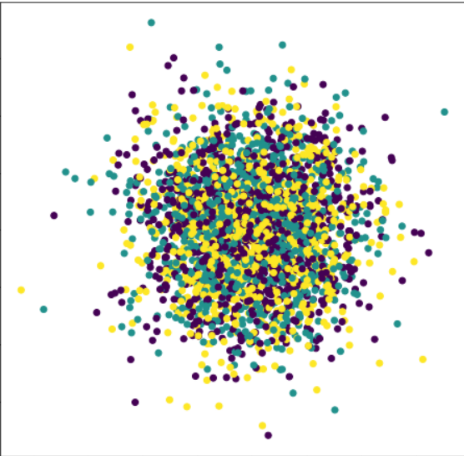
Objectives Achieved So Far
We did the testing of our current models based on Sparse BNNs and Feature Selection using various plots and metrics on two different kinds of data; one was Two Moon dataset with some random noise, and second was Random data with few important features.
Two-Moon Dataset
Random Data

Slide 6
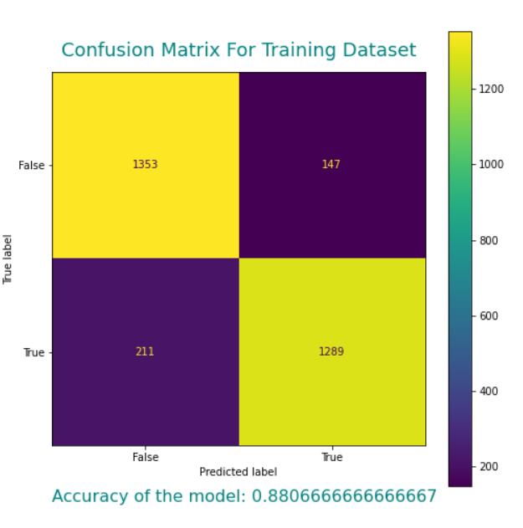
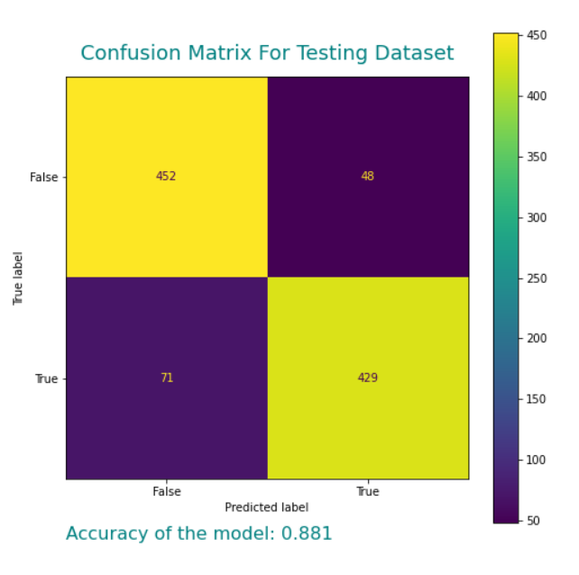
Results- Two Moons Dataset
(Using Sparse BNN class)

Slide 7
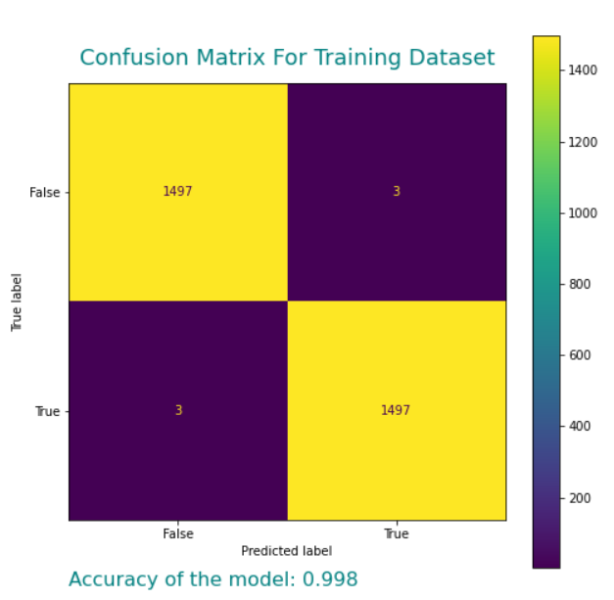
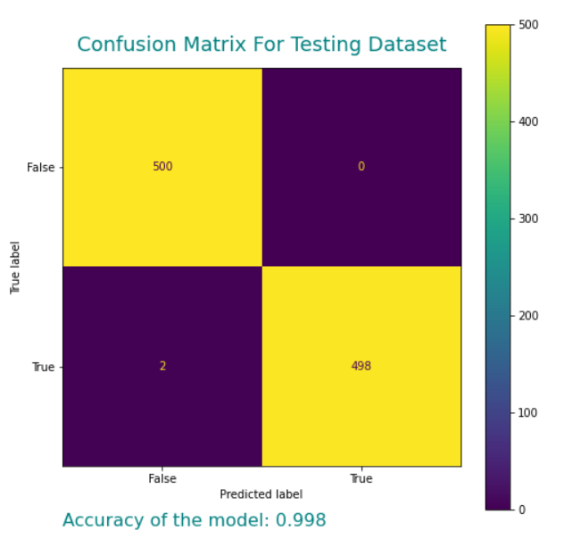
Results- Two Moons Dataset
(Using Feature Selection class)

Slide 8
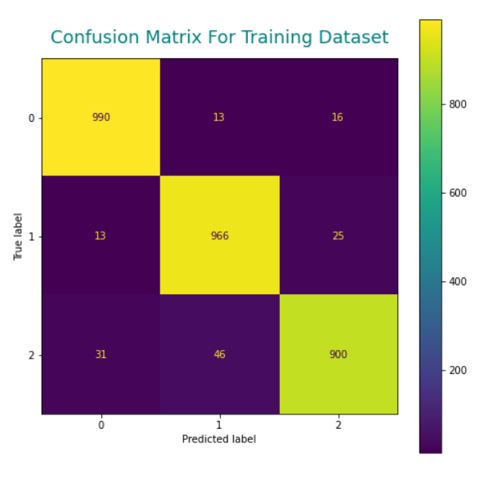
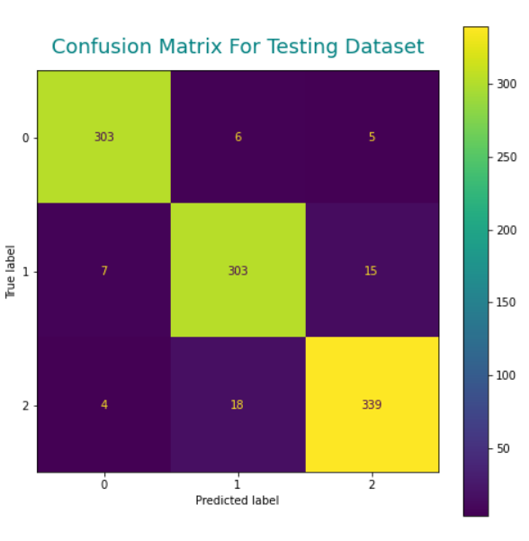
Results- Random Dataset
(using Sparse BNN class)
Accuracy: 0.95
Accuracy: 0.94

Slide 9
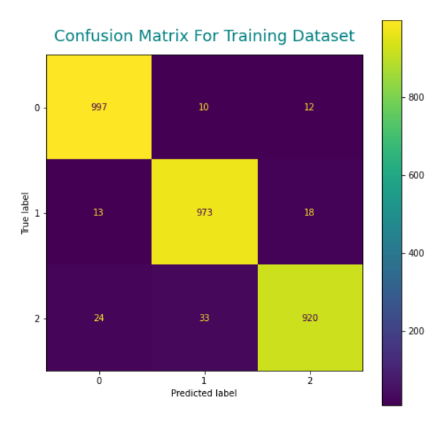
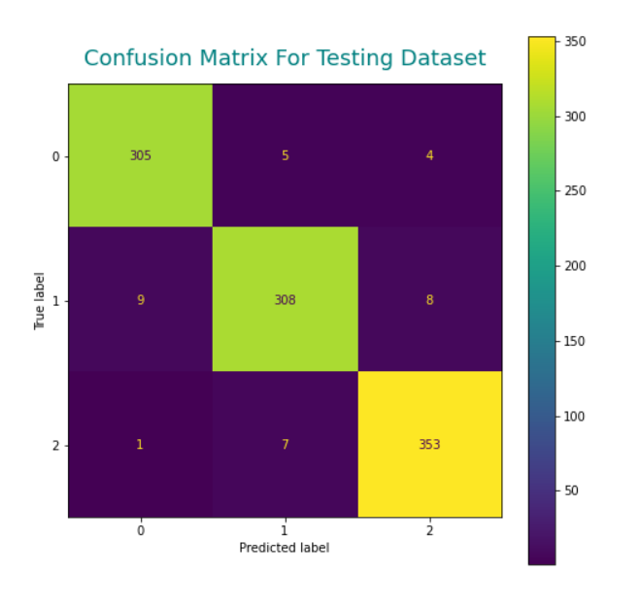
Results- Random Dataset
(using Feature Selection class)
Accuracy: 0.96
Accuracy: 0.97

Slide 10
Future Plans for Improvement
Extending the model so that it can provide the essential features which are responsible for predicting the particular classes and subclasses of Cancer.
Understanding the concepts and techniques in the Auto-Encoding Variational Bayes paper like SGVB (Stochastic Gradient Variational Bayes) & Auto-Encoding VB (AEVB) algorithm, and implement them to further enhance the model, if applicable.
Analyzing the effect of using Laplace Distribution in place of Gaussian and Dirac distributions in the Spike-and-Slab priors in the model.
Working with actual data (i.e cancer dataset), and also cross-verifying our results with the Genomic Data Commons (GDC) Data Portal so that we can improve our model accordingly.
Optimizing the model algorithm by-
Changing the Initialization
Changing the Loss Function
Changing the Model Structure

Slide 11
References
Data:
Genomic Data Commons (GDC) Data Portal by National Cancer Institute (USA)
Stochastic Gates
Papers:
Efficient Variational Inference for Sparse Deep Learning
Auto-Encoding Variational Bayes
An Introduction to Variational Inference
Learning:
Pytorch
Bayesian Statistics
Gumbel Softmax
Spike and Slab Priors
Why Bayesian Neural Networks?
Categorical Reparameterization

Slide 12
Thank You!

